Slide 1
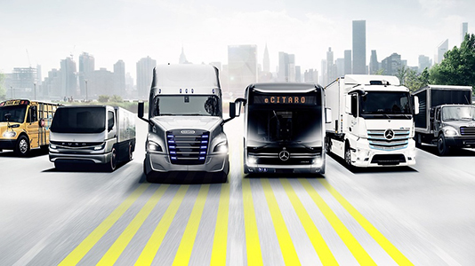
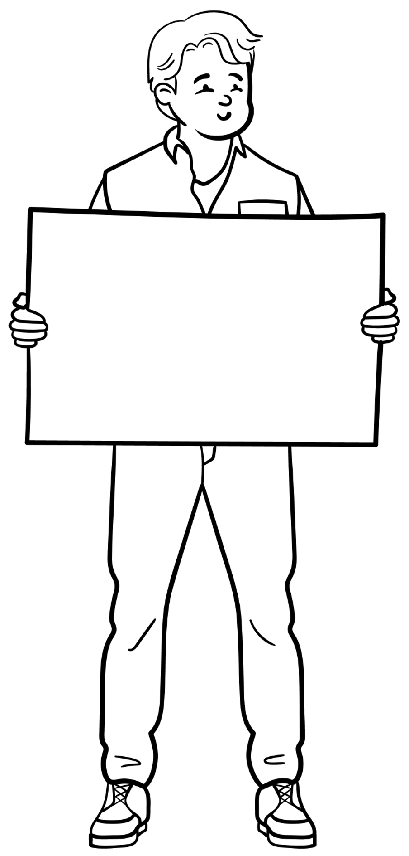
Group
11
ANT Trucks Data Analysis
Aishwarya Jamma Maninder Singh Prarthana Barangule Surya Narkedamilli Vignesh R

Slide 2
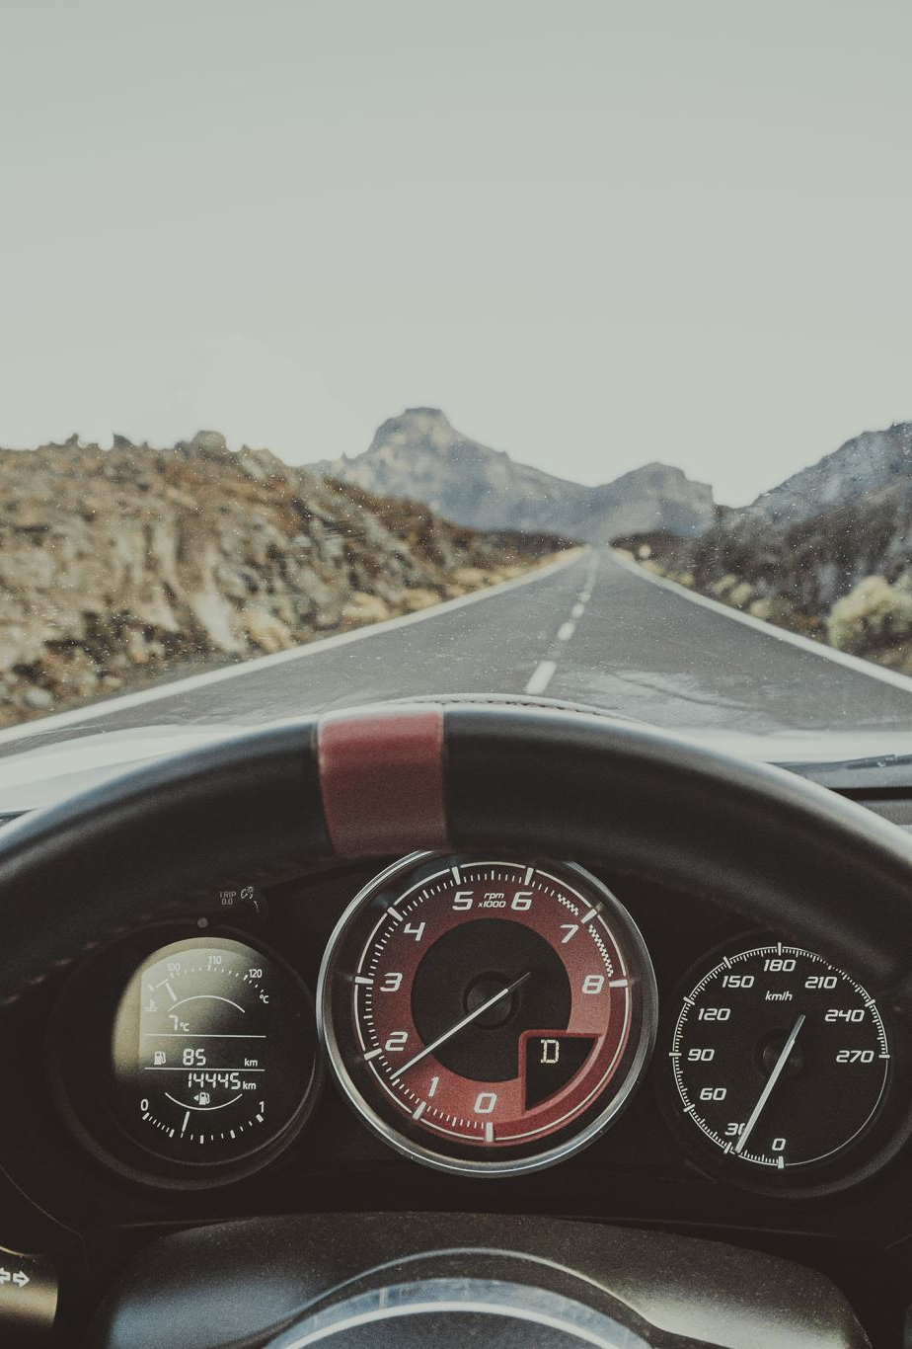
Business Objective
Analyze and assess risk factors for drivers based on a variety of parameters, such as events, the average distances drivers travel, their typical speeds, and mileage.
Utilize the data to spot risky drivers that violate the law.
Determine the optimum vehicle model based on the mileage, average mpg, and risk factor such that ANT may contract with the truck manufacturer to acquire each of its trucks to receive lower prices on new purchases as well as to make maintenance operations more efficient.
Finally, preventing accidents through disseminating knowledge that will make each driver's risk as little as feasible.
Notes:
Helping the business expand it’s operations

Slide 3







Process flow
Download CSV Data from elearning
Save data on local machine
Transfer files from local to VM ware
Move files from local directory to HDFS
Implement Data Analysis and Visualizations
Using Impala
ODBC Driver connect to Tableau
Import files into Hive using LOAD DATA INPATH command
Notes:
Helping the business expand it’s operations

Slide 4
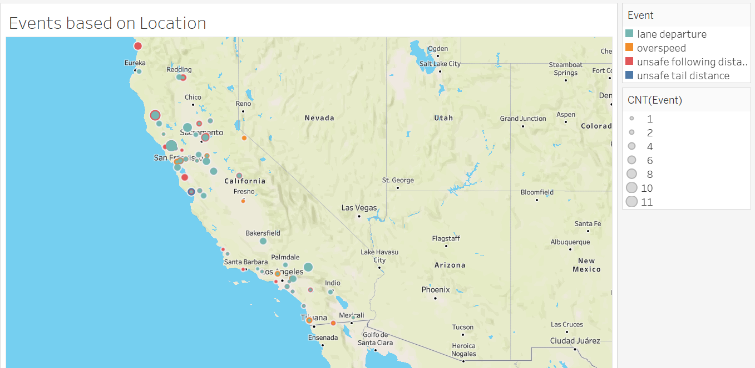
Events with respect to Location
The distribution is depicted here according to city and geographic location.
The bubble size indicates the number of events happening and color represents the different type of events.
It is evident that most violations occurred in California's North-West region.

Slide 5
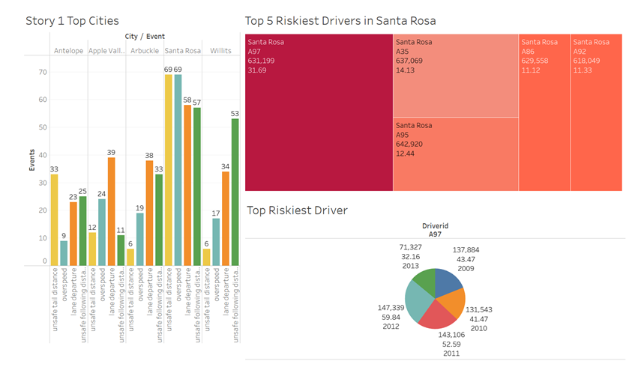
A97 is the riskiest driver who has driven 631,199 miles and has the risk factor of 31.69 in Santa Rosa
According to events, the top 5 cities in California are Antelope, Apple Valley, Arbuckle, Santa Rosa, and Willits as shown on the bar chart.
Among these A97, A35, A95, A92, and A86 are the most dangerous drivers overall, along with the risk factor and total miles, in Santa Rosa, which is the top city.
Notes:
1.Fleet range

Slide 6
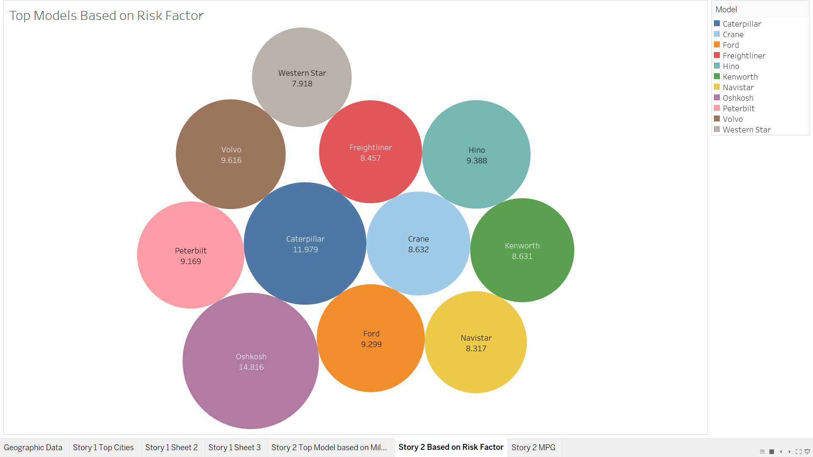
Oshkosh Model trucks are having the most risk factor compared to other truck models based on risk factor
The different colors and sizes depict the risk factor level for different company trucks.
From our observation, models Oshkosh, Caterpillar, Volvo, Hino, and Ford trucks have the highest risk factor among all 11 models present.
Notes:
1.Fleet range

Slide 7
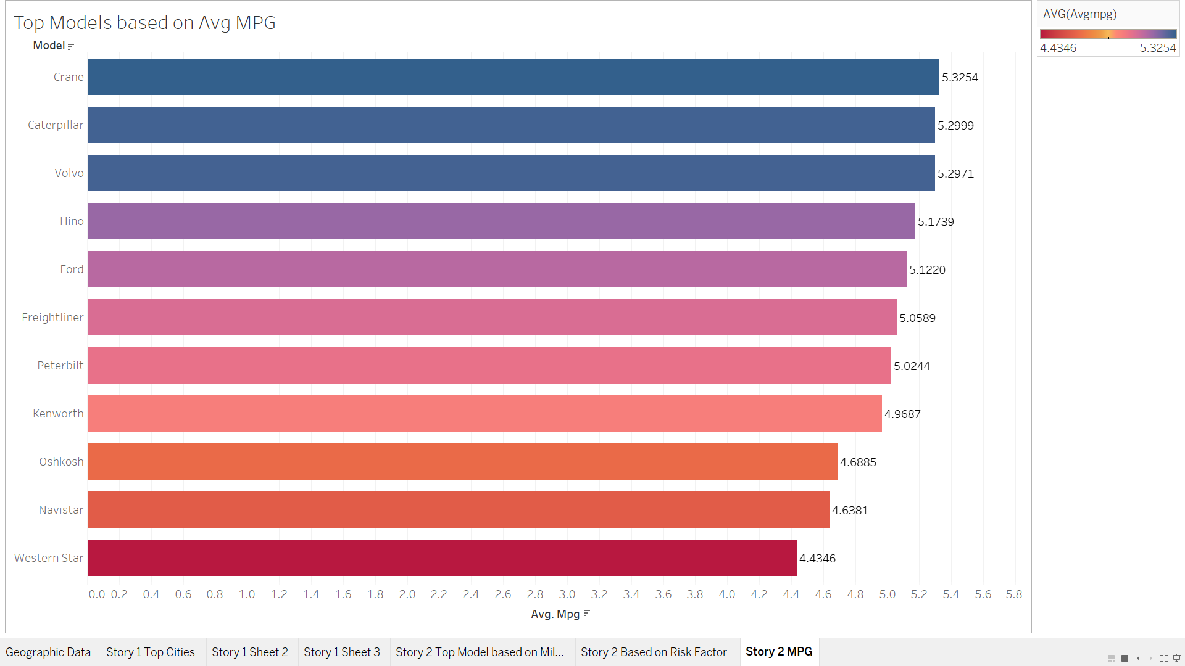



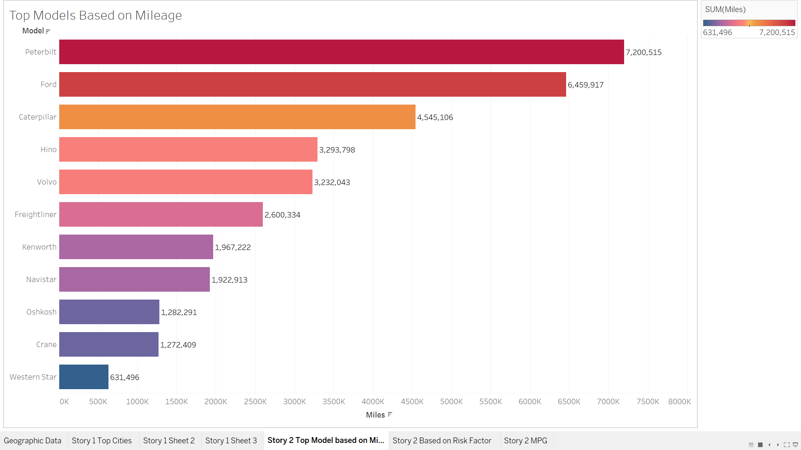
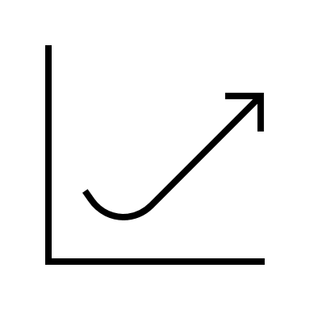
Mileage Analysis
The first chart shows the distribution of Truck models based on average mileage. We can see Crane, Caterpillar, and Volvo has the highest average mileage​
The bar chart represents the distribution of truck models based on mileage (total miles covered). We can observe that Peterbilt, Ford, and Caterpillar are the top 3 models that covered more miles than other models.​
Risk factor
Mileage

Slide 8
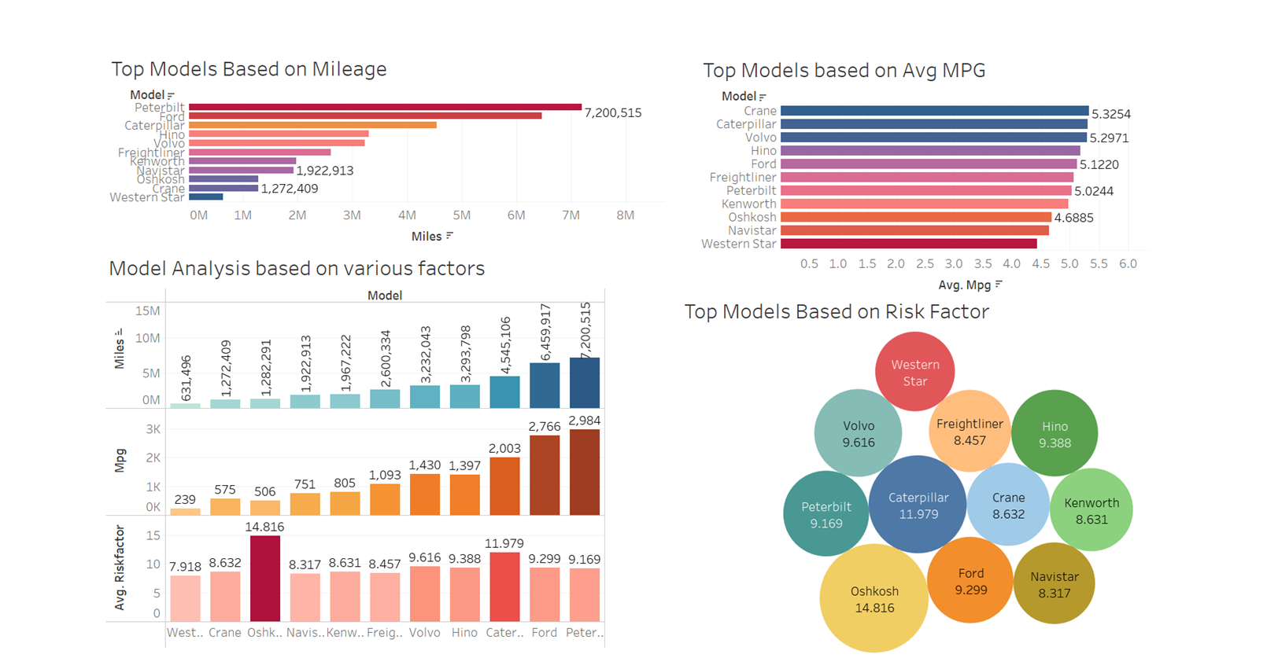
Notes:
Assuming that all drivers maintain more or less similar range of speed, MPG is more dependent on Model than driver. Among Ford, Caterpillar and Crane, Ford has high median MPG.ANT should invest more in truck models from Ford or Caterpillar,and can reduce count of other models.
we dont have enough data about the traffic and the road condition so we need some added analysis to confirm our statement or insight

Slide 9

Conclusion & Recommendations for ANT
Northern California truck drivers should receive specialized training. The riskiest drivers should receive ongoing training, be monitored, and be rewarded for completing assignments.
During the training phase, each dangerous driver should be paired with a proficient driver.
This arrangement is known as a buddy program. Based on the observed insights, the training program has to be adjusted.
ANT needs to designate a dedicated staff to monitor truck drivers in accident-prone locations. Longer rides shouldn't be provided to drivers with a history of serious accidents.
The ANT company has to invest in trucks which have greater mileage with fewer maintenance to have good profits
Notes:
Penalties for aggressive drivers.
Incentives for defensive drivers
Better staffing plan to reduce burden on drivers
Purchasing trucks with lane assist systems and advance driver aids. Leverage technology to reduce human error.
Oshkosh model poses high risk of accidents.
Take feedback from drivers to enhance work satisfaction

Slide 10

THANK YOU !
Notes:
Penalties for aggressive drivers.
Incentives for defensive drivers
Better staffing plan to reduce burden on drivers
Purchasing trucks with lane assist systems and advance driver aids. Leverage technology to reduce human error.
Oshkosh model poses high risk of accidents.
Take feedback from drivers to enhance work satisfaction

